Slide 1

Customized Production Order Business Engine
Amun Stalder
Christopher Galli
Jan Kruta
Urs Känel

Slide 2
Agenda
As-is Process
Your New Business Engine
Demonstration of business engine
Conclusion
Outlook

Slide 3
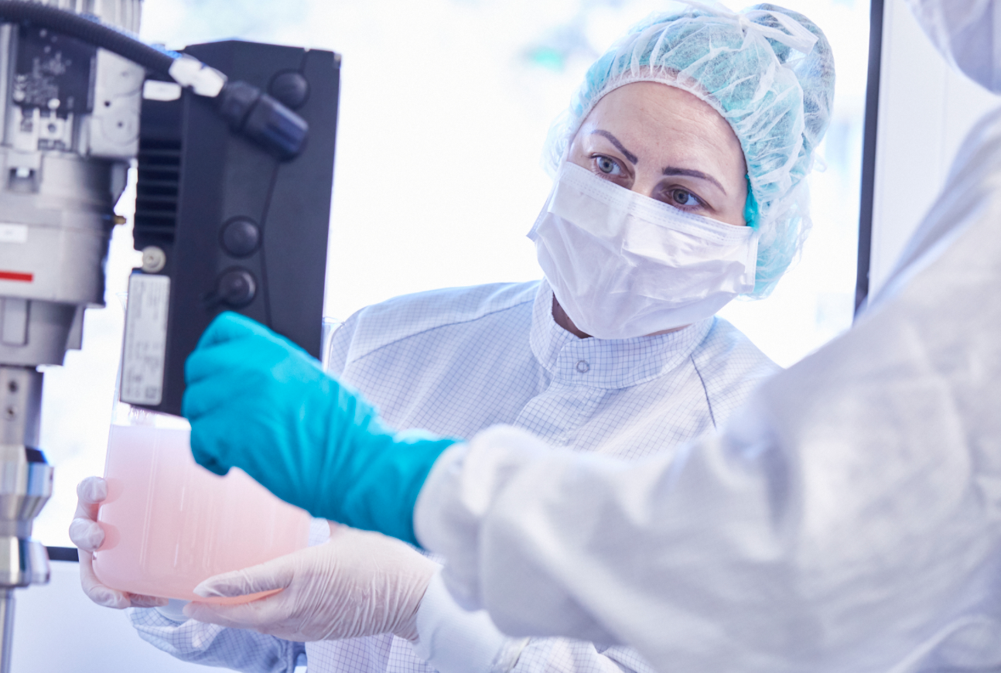
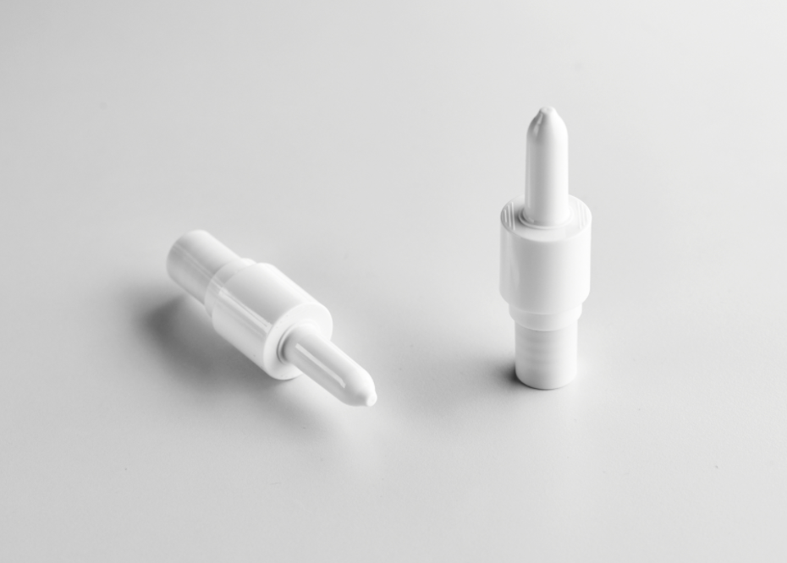
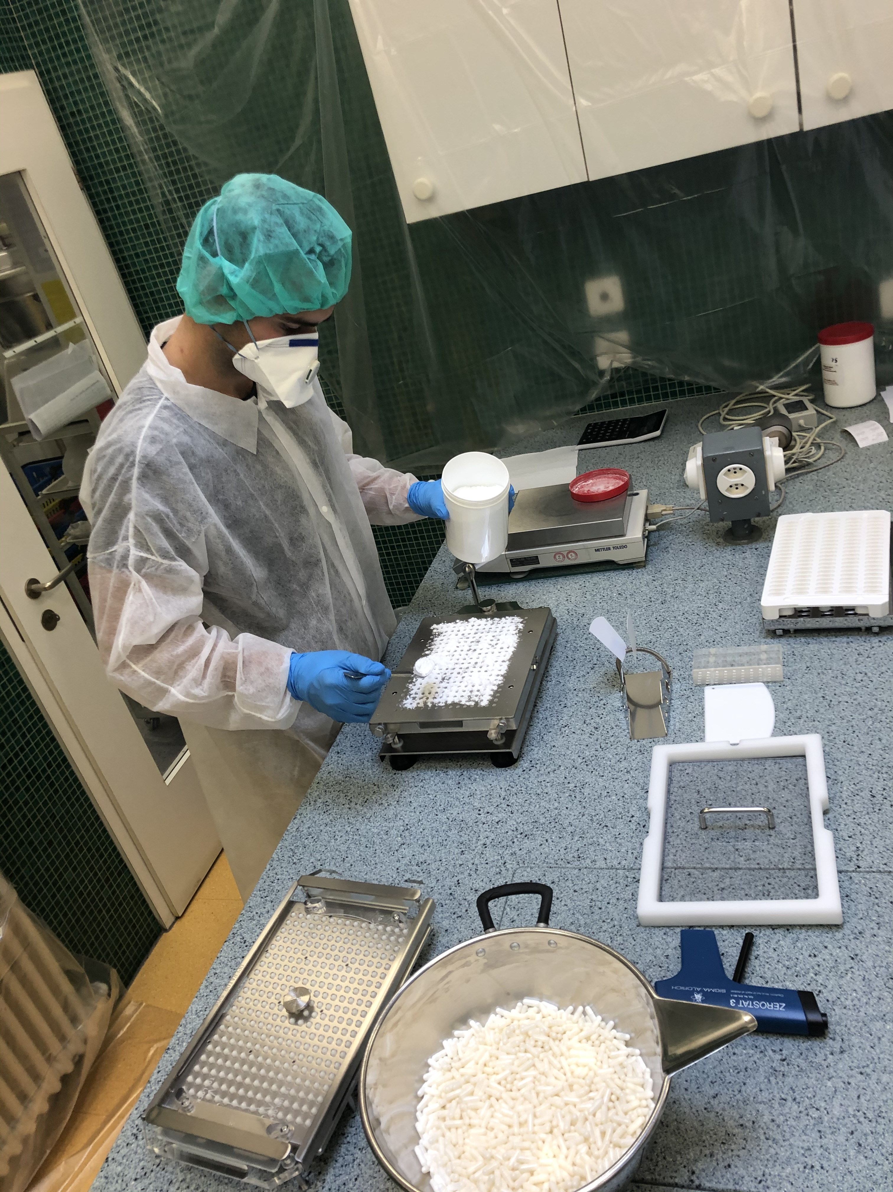
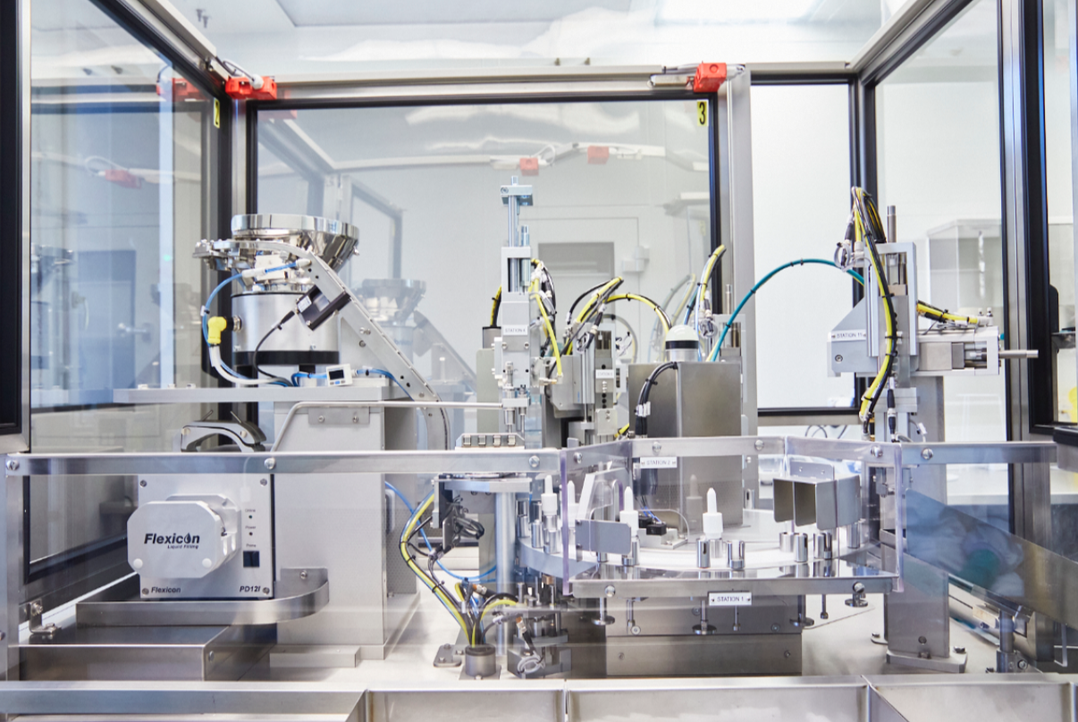
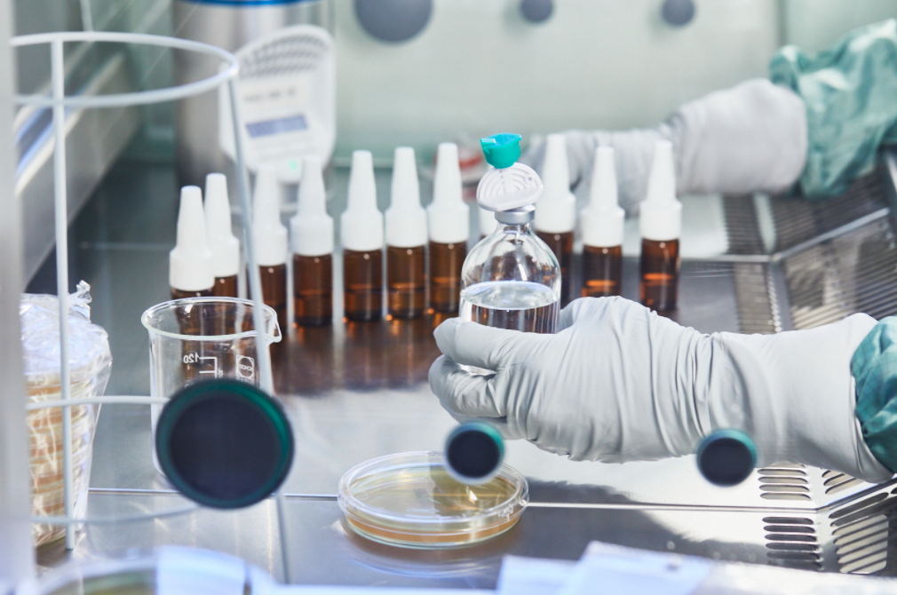
Business Case
Pharmacy Lab Clean Room Lab Production of many Medicines

Slide 4
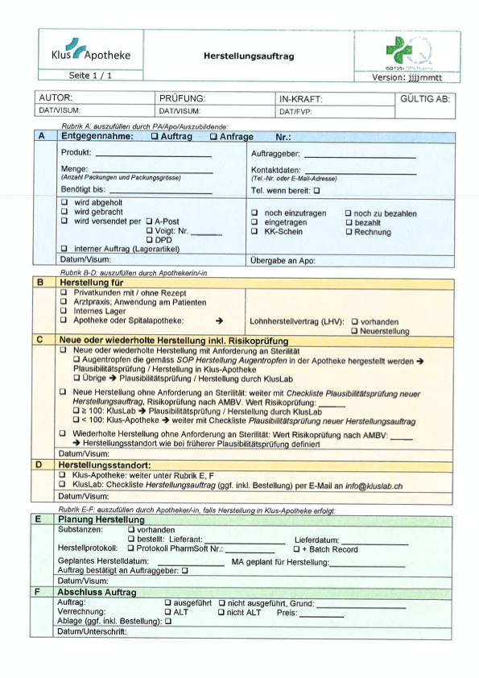
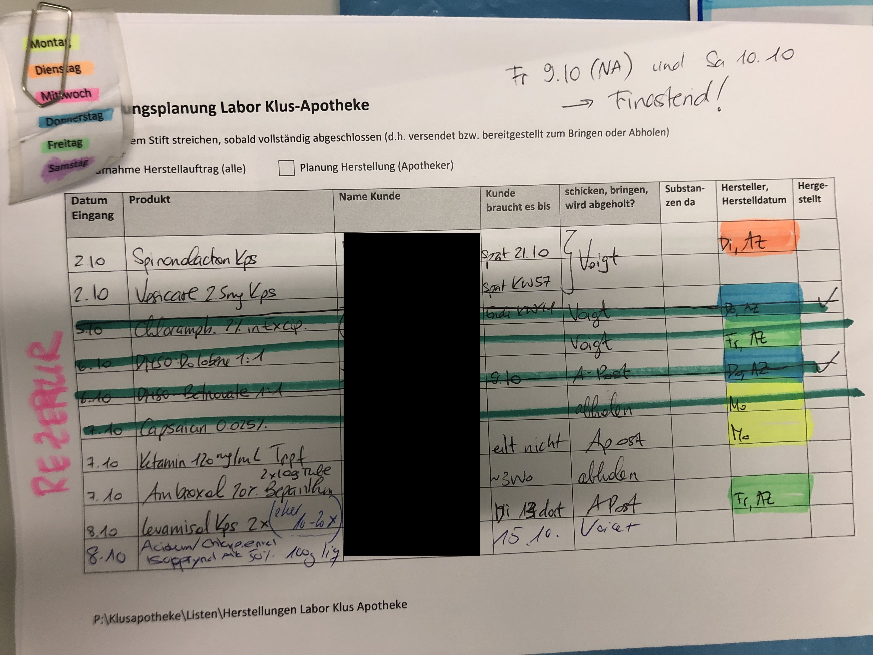
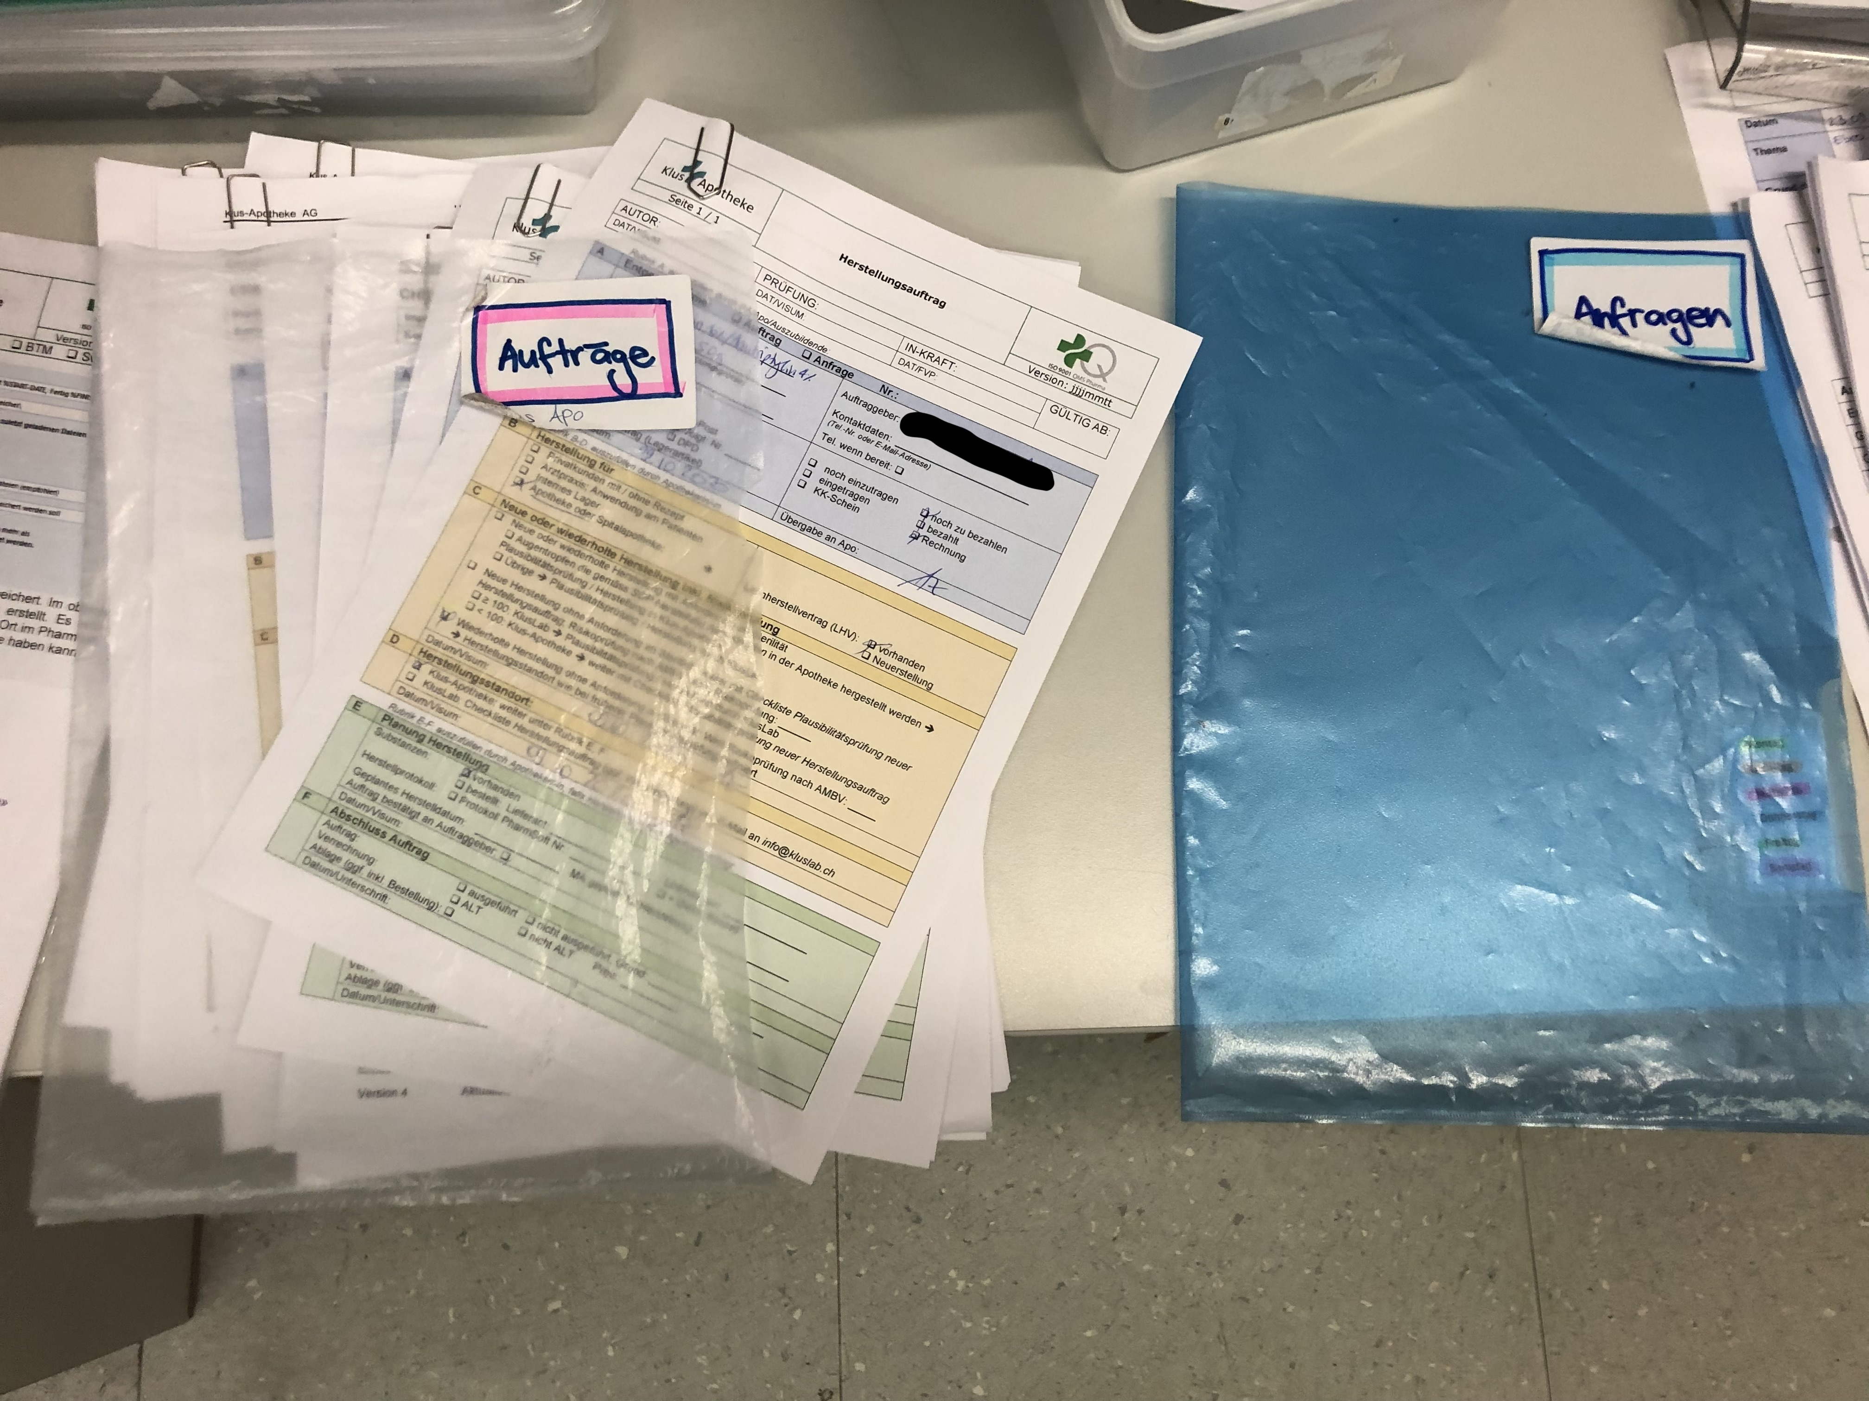
Current State: As-is Process
Production Order forms on paper
Hard to keep overview
List of all productions on paper
Digitalization needed!

Slide 5
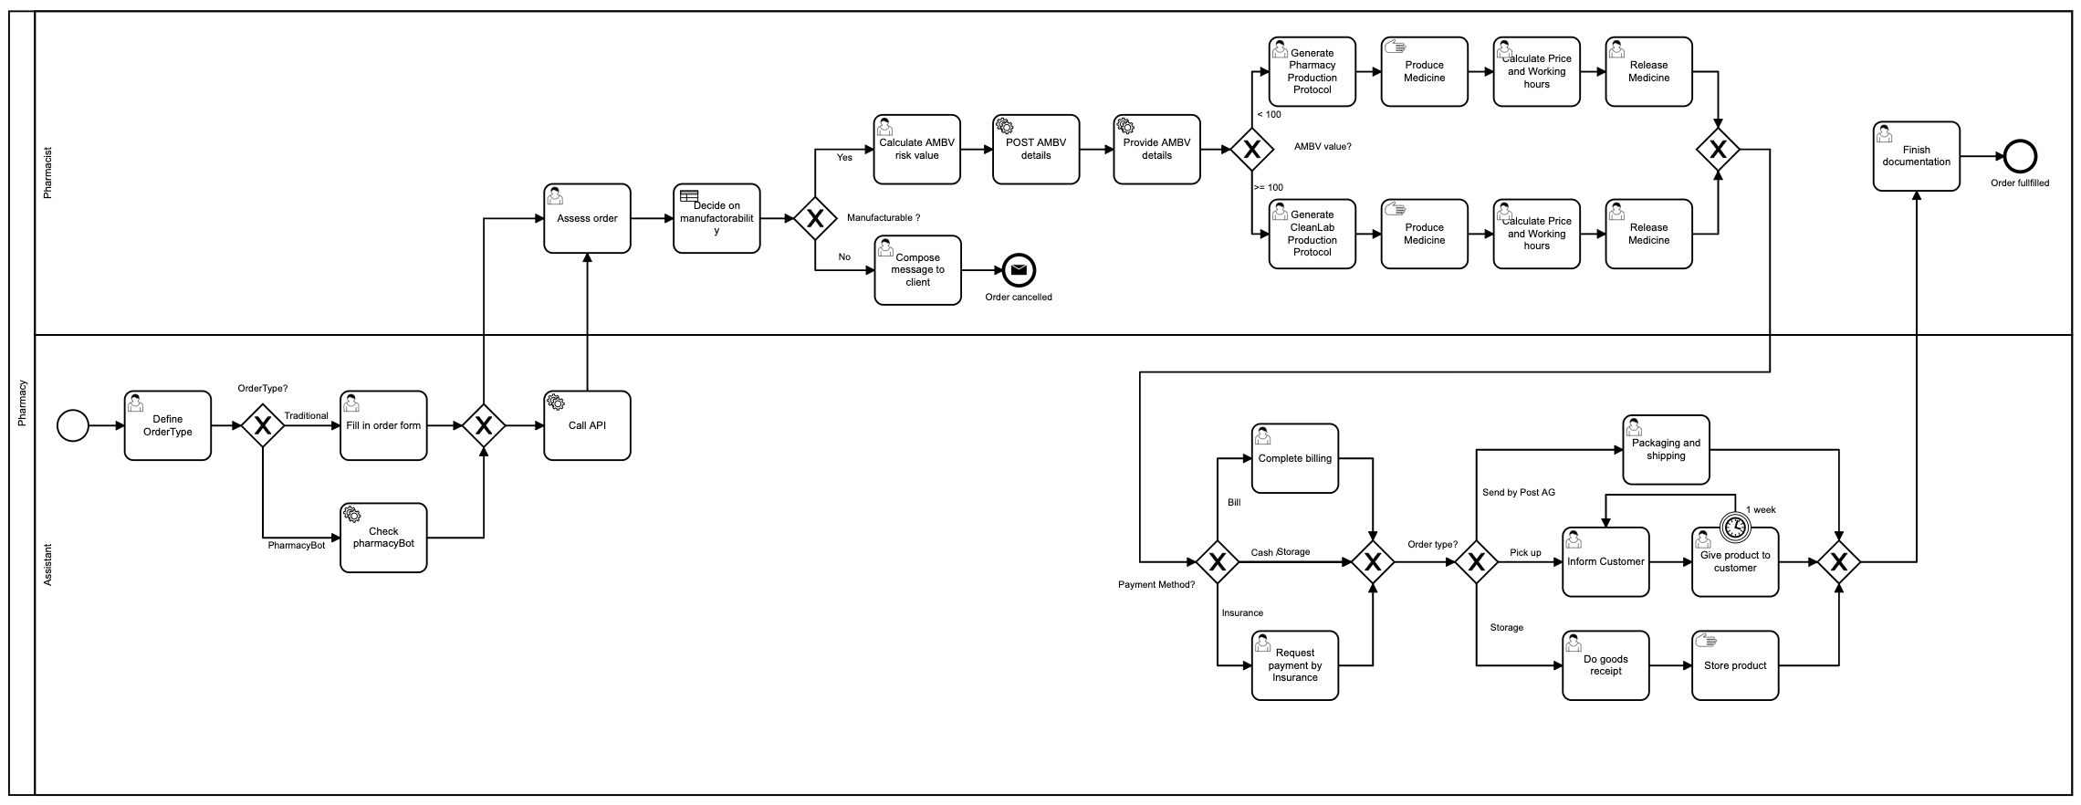
Your New Business Engine

Slide 6
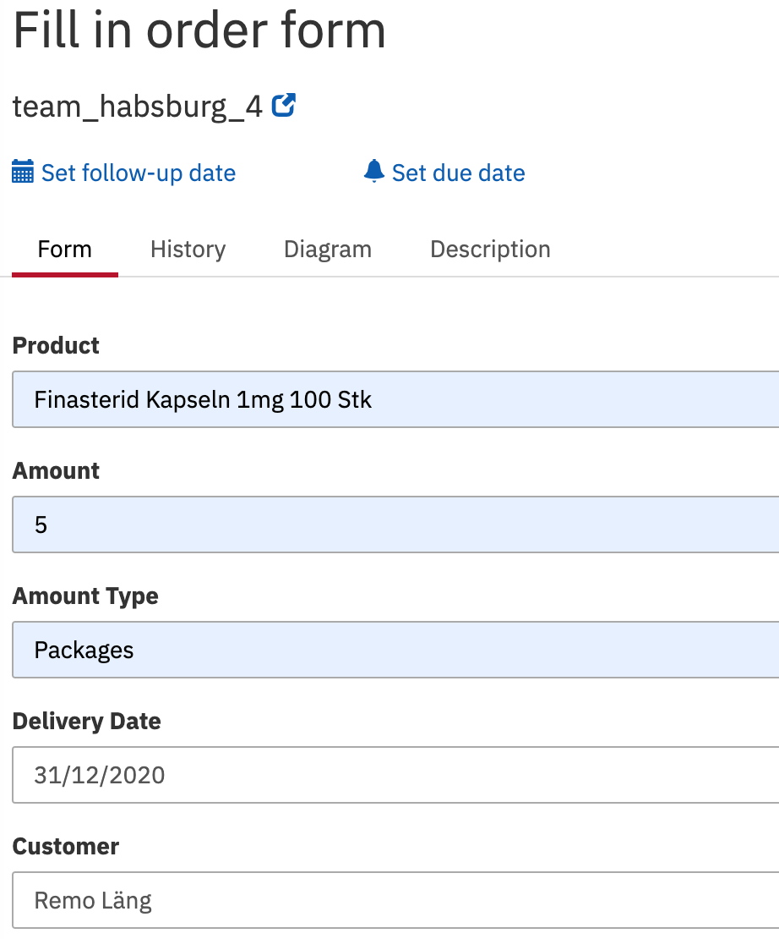
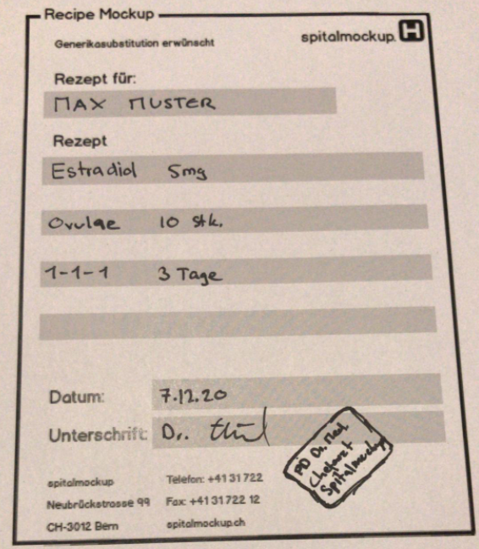
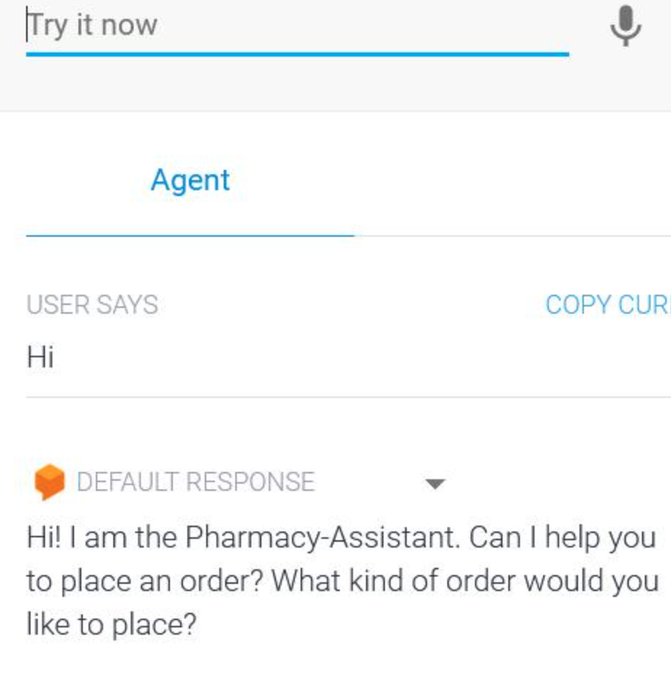
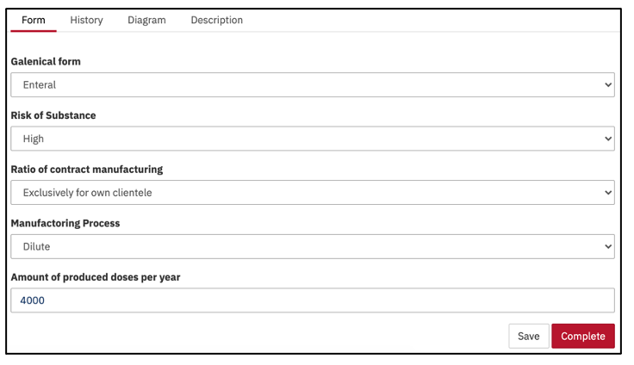
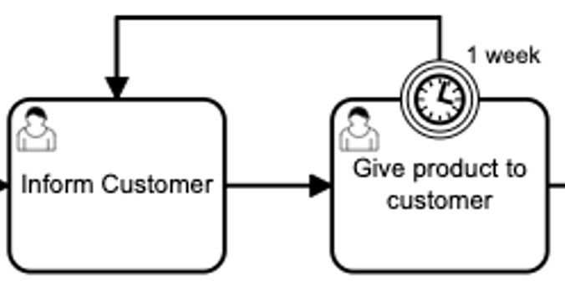
New Features and Advantages
No more paperwork!
Digital Entry Forms
Pharmacy chatbot
Handwriting decrypter
Integrated AMBV-calculator
Automatic reminders

Slide 7
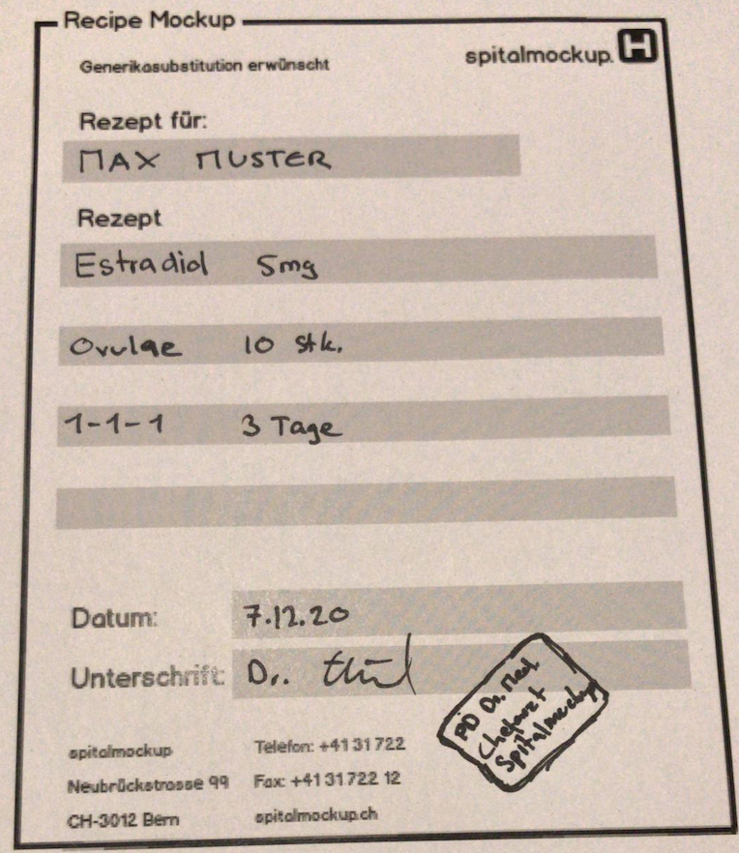
Live Demo: Lina Müller
Name: Lina Müller
Condition: Hygonadism
Medicine: Estradiol 5mg, 0-0-0-1
Delivery: Pick Up
Payment: Bill

Slide 8
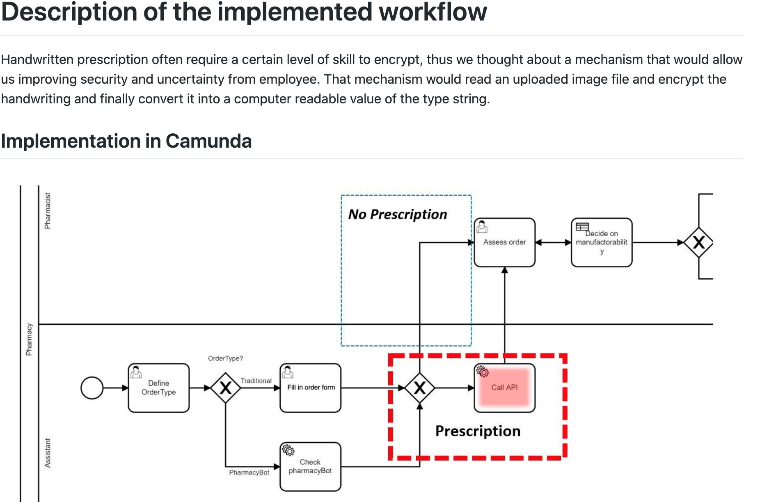
Further information
https://github.com/DigiBP/Team-Habsburg-Castle/wiki

